Slide 1
Fundamentals of programming:
Seminar 7
Diyora Sayfutdinova – dsayfutdinova@wiut.uz
Computing Department

Slide 2
Quick Recap
What are the advantages of using functions?
What is the difference between a parameter and an argument?
What are some built-in functions Python provides
How to get help about a function?
How to define a function?
What is the difference between return and print()?
What is indentation and how important is it?
What are the differences between Tuples and Lists?
Computing Department

Slide 3
Syntax of Function
keyword
name of the function
def is_odd(num):
"""
Input: num, a positive int
Returns True if num is odd, otherwise False
"""
remainder = num % 2 != 0
return remainder
print(is_odd(7)) → call/invoke a function
help(is_odd) → to get the idea of what function does
Parameter
docstring/specification
body of the function
Computing Department

Slide 4
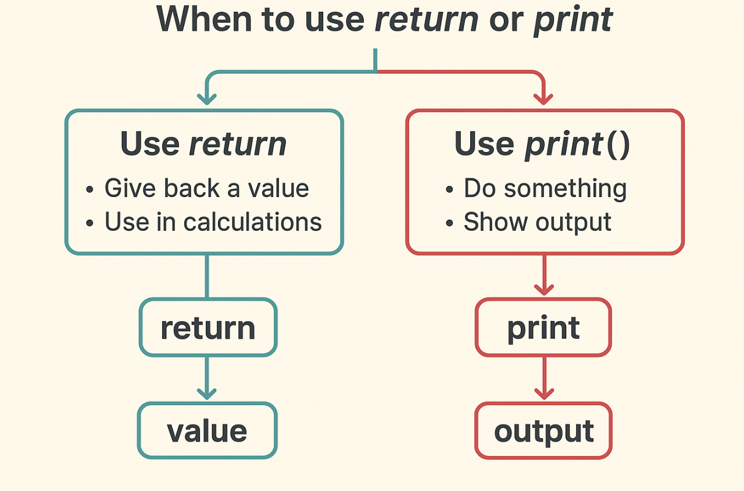
print() vs return
Use return when you need the function to give back a value to your program to use it later in calculations ex: calculate something and give the result back.
Use print() If the function is just performing an action, not producing a value ex: Print or display something only.
Computing Department

Slide 5
Print vs Return
def add(num1, num2):
sum = num1+num2
return sum
print(add(2, 2)) → 4
def add(num1, num2):
sum = num1+num2
print(sum)
print(add(2, 2)) → ?
Computing Department

Slide 6
Print vs Return
def add_with_return(num1, num2):
sum = num1+num2
return sum
print(add_with_return(2, 2))
def add_with_print(num1, num2):
sum = num1+num2
print(sum)
add_with_print(2, 2)
Computing Department

Slide 7
Print vs Return
def add_with_return(num1, num2):
sum = num1+num2
return sum
result_return = add_with_return(2, 2)
print(result_return*2) → ?
def add_with_print(num1, num2):
sum = num1+num2
print(sum)
result_print = add_with_print(2, 2)
print(result_print * 2) → ?
Computing Department

Slide 8
Tuple vs Lists
colors = ["red", "green", "blue"]
colors[0] = "yellow"
print(colors)
colors = ["red", "green", "blue"]
colors.append("black")
print(colors)
colors = ("red", "green", "blue")
colors[0] = "yellow"
print(colors) -> ?
colors = ("red", "green", "blue")
colors.append("black")
print(colors)
Computing Department

Slide 9
Scopes
Local → visible only inside a function
Global → global, available everywhere in file
Enclosing → inner function accesses the variable of outer scope (nested functions)
built-in → provided by python → always available
Computing Department

Slide 10
Scopes
x = 100 → global
def local_scope():
x = 50 → local
print("Inside function:", x, id(x))
local_scope()
print("Outside function:", x, id(x))
Computing Department

Slide 11
Try it!
create a function which takes multiple values from the user, store them as a tuple, and display that tuple.
Hints:
use an input()
Convert str to tuple
Computing Department

Slide 12
Try it!
Create a function to take multiple integer inputs from the user, store them in a tuple, and calculate:
the average
the total (sum)
the number of elements entered.
Computing Department

Slide 13
Try it!
Create a function that:
Gets two integers from the user.
Checks if exactly two are entered.
Swaps their positions.
Prints the swapped result.
Hint:
Tuple unpacking and swapping
Computing Department

Slide 14
Try it!
Write a function to guess a number:
The computer picks a random number between 1 and 10
and you try to guess what it is.
If you guess wrong, it gives you a hint
either “Too small” or “Too high”
until you guess correctly.
Then you can choose to play again or quit.
Hint:
Import random
Computing Department

Slide 15
Try it!
Write a program similar to shopping system where a user can:
Add items to shopping list
Remove items from shopping list
View items in the shopping list
Keep running the loop until the user interrupts
Hints:
use a list to store the items
create a separate functions for each action(add, remove, view)
use while loop to keep running until it is interrupted.
Computing Department

Slide 16
Try it!
Write a function that
Asks the user for numbers (max num of elements should be 4)
Converts them to a tuple
Checks the number of elements should not be more than 4 and no less than 2
If not, calculates and shows the average.
Computing Department

Slide 17
Try it!
Write a function that:
Asks the user to input two tuples, each with 3 numbers.
Calculates the average of the second tuple.
Multiplies each number in the first tuple by that average.
If the outputs can be evenly divided by 3, the function returns True; otherwise it returns False.
Computing Department

Slide 18

Computing Department

